Slide 1
RUNGTA COLLEGE OF DENTAL SCIENCES AND RESEARCH
Lasers in Endodontics
DEPARTMENT OF CONSERVATIVE DENTISTRY AND ENDODONTICS

Slide 2
Specific learning Objectives
At the end of this presentation the learner is expected to know ;
Core areas* | Domain ** | Category #
Introduction | Cognitive | Must know
Definitions | Cognitive | Must know
Classifications | Cognitive | Must know

Slide 3
Content
History of lasers
Classification of lasers
Properties of lasers
Components of lasers
Lasers techniques used in Endodontics

Slide 4
HISTORY OF LASERS
“Laser” is an acronym of light amplification by stimulated emission of radiation.
1.1958 Charles Townes and Arthur Schawlow coined the word “maser”
2. Word laser was first coined in 1957 by Gordon Gould
3. Theodore Maiman , who introduced the acronym “laser,”
4. 1965, the physicist Leon Goldman was the first to use a ruby laser

Slide 5
What is a wavelength ?
What is electromagnetic spectrum?
What is Visible spectrum of radiation ?
What is invisible spectrum of radiation?
Notes:
It is the distance between consecutive corresponding points of the same phase on the wave, such as two adjacent crests, troughs, or zero crossings, and is a characteristic of both traveling waves and standing waves, as well as other spatial wave patterns.Accordingly, the spectrum of visible light covers a range approximately between 0.4 and 0.7 μm (400–700 nm); however, the border between visible and invisible spectrum is not precisely defined, depending on different factors, and is between 380 and 400 nm on one side and 700 and 800 nm on the other side.

Slide 6
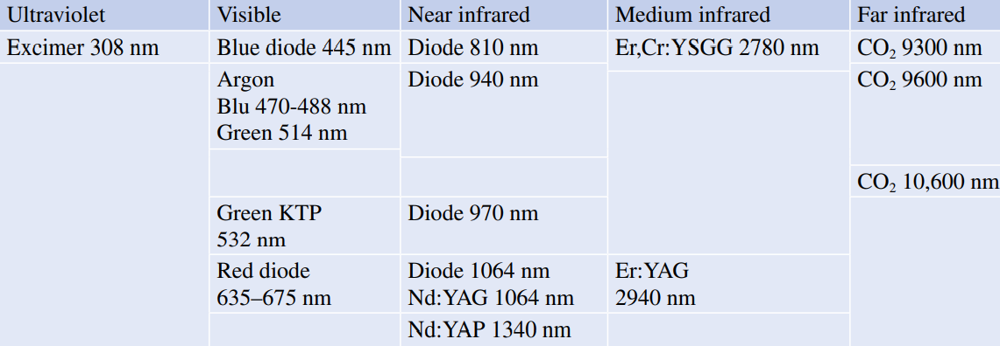
Classification of Dental Lasers in the Electromagnetic Spectrum of Light
1.According to their wavelength position
2.According to their clinical applications

Slide 7
Notes:
Beyond the violet zone, with a wavelength of less than 0.4 μm (400 nm), there is a zone called ultraviolet, between 0.4 and 0.01 μm. On the left side of this zone, with a decreasing wavelength, there are the X-rays extended to a wavelength of about 0006 μm. In the more external part, there are the gamma rays.
On the right side of this zone, there are the microwaves and farther the radio waves (short 1–100 m; medium 200–600 m; far >600 m).

Slide 8
Properties of Laser Light
LASER
LIGHT
Wave Characteristics
Photonic Corpuscular Characteristics
Collimated
Coherent
Monochromatic
Visible or invisible spectrum

Slide 9
Components of Laser
HAND PIECE AND TIPS
Optical Resonator
Active Medium
Energy Source
Controller
Cooling Unit
Delivery System

Slide 10
Photons, emitted by the excitement of the active medium (stimulation), are reflected inside the optical cavity and pass through the active medium many times, amplifying their energy
The active medium can be solid, liquid, gas, or a semiconductor (diode) and determines the specifi c wavelength of different lasers; its name identifies different lasers

Slide 11
Source of energy is usually represented by an electric coil or a diode laser or a flash lamp.
Controller is a microprocessor that verifies the characteristics of the production of laser energy, the laser emission mode (continuous wave, mechanically interrupted or pulsed)
The cooling system is necessary to dissipate the heat produced during the pumping process
There are various systems of delivery, depending on the difference of the wavelength carried: optic fiber, hollow fiber, and the articulated arm

Slide 12
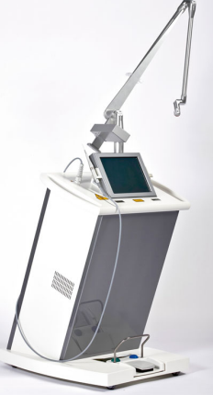
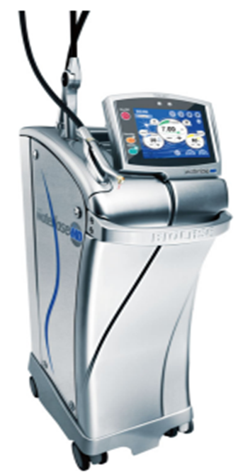
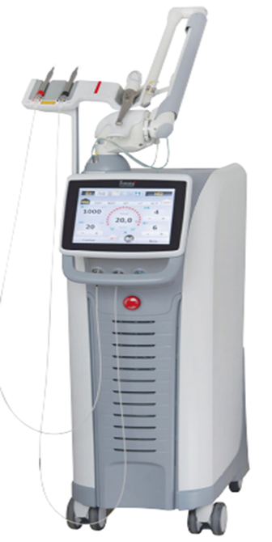
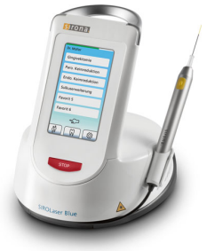
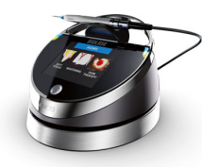
The ideal handpiece should be small, lightweight, and handy. Some handpiece does not have any terminal tip, but a reflecting mirror which works at a distance from the tissue (tipless or noncontact or far-contact handpiece)

Slide 14
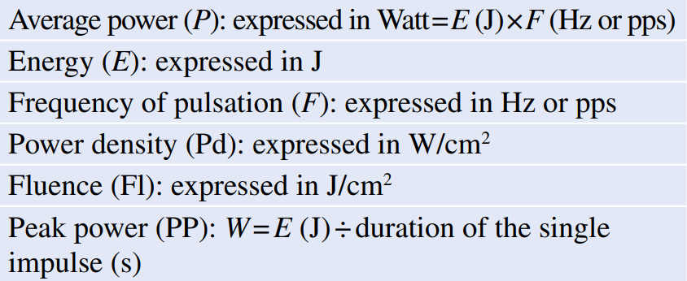
LASER PARAMETERS
LASER EMISSON MODE
1.Continuous Wave and Gated Mode
2. Free-Running Pulsed Mode
3. Pulse Duration and Pulse Repetition Rate

Slide 15
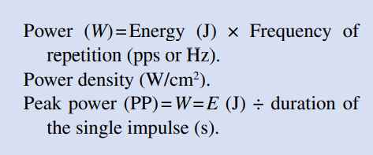
LASER POWER
LASER EMISSON MODE
1.Continuous Wave and Gated Mode
2. Free-Running Pulsed Mode
3. Pulse Duration and Pulse Repetition Rate

Slide 16
OPERATOR MODALITY
Operator modality of the clinician includes distance from the target, angulation of the irradiation, speed of the movement, and time of irradiation.
Distance from the target influences energy density and power: when the distance between fiber and tip of the laser increases, the density of emitted energy decreases, enlarging the size of the spot due

Slide 17
Laser-Tissue Interaction in Endodontics
• Reflected • Absorbed • Diffused • Transmitted
Reflection is an optical phenomenon due to the lack of affinity and absorption of light from the target, which, once hit, rejects the light completely
Absorption: It is the expression of high affinity between light and the target which retains light in the point of irradiation.
Diffusion depends on the capacity of the light to spread irregularly deeper into the target. The portion of laser energy which diffuses into the tissues is responsible for the therapeutic effects of some wavelengths

Slide 18
Transmission is the passage of light through a body or tissue, in the absence of interaction with it and, in consequence, without producing physical or biological effects

Slide 19
Laser Effects in Endodontics
PHOTOTHERMAL EFFECT
Results from the direct laser irradiation on the dentinal walls, when the lasers are used with the conventional technique for the decontamination and removal of the smear layer, positioning the fi ber inside the Canal
PHOTOCHEMICAL EFFECT
Causes the activation of photosensitive substances (photosensitizers) inoculated in the canal and responsible for the antibacterial effects of the photoactivated disinfection (PAD), without direct irradiation (and interaction) on the dentin
PHOTOTHERMAL EFFECT PRIMARILY AND PHOTOMECHANICAL- ACOUSTIC EFFECT
This activate the commonly used irrigants in endodontics during the laser-activated irrigation and PIPS, without any direct irradiation (and interaction) on the radicular dentin, when the irrigant liquids are present and remain in the canal

Slide 21
PARAMETERS INFLUENCING LASER ENDODONTICS
Continuous Wave Mode
Diode lasers emit the energy in continuous wave (cw).
The power higher than 1.5 W, the continuous emission in the root canal is inadvisable because of the excessive thermal damage released on the canal’s walls
Therefore Chopping or Gating of emission is important as it produces more or less thermal effect.
Short duration of t on , of 10–20 ms, is correctly and effectively used in endodontics with diode lasers at a power ranging from 2 to 3 W

Slide 22
2.Pulse Repetition Rate
The more frequent the repetition is, the shorter the time for thermal release is and the greater the thermal effect on the tissue is
Repetitions of pulse (5–10 Hz/ pps) allow a longer time for thermal relaxation and more control of tissue irradiation
3. Fluence and Power Density
It depends on the diameter of the tip used and of the irradiated square surface;
For the same amount of energy and power emitted, larger is the diameter of the fiber or the irradiated surface, and lower is the density of power and energy.

Slide 23
4. Pulsed Mode and Pulse Duration
Short duration of pulse permits to control the side effects of thermal emission; when the energy is concentrated in a short time
5. Distance Between Target and Fiber
When the distance between the target and fiber/tip of the laser increases, the density of emitted energy decreases, enlarging the size of the spot due to the effect of a certain grade of emission divergence and increasing the necessary amount of energy for the interaction

Slide 24
LASER TECHNIQUES USED IN ENDODONTICS
Conventional Laser Endodontics or
PAD-Photoactivated Disinfection Or
Laser Activated Irrigation Or
PIPS-Photon Induced Photoacoustic streaming
aPDT-antibacterial Photodynamic Therapy
Direct Laser Irradiation

Slide 25
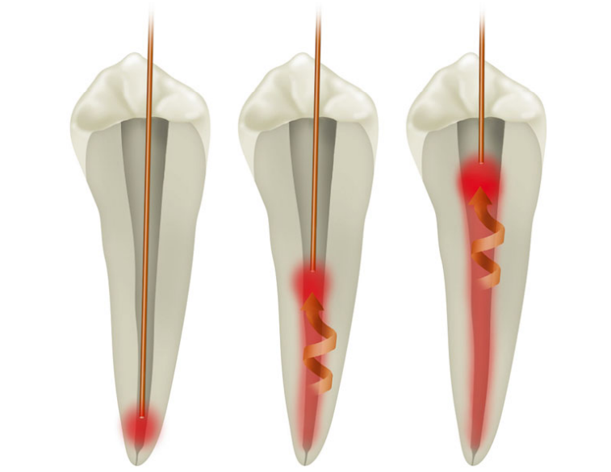
1.CONVENTIONAL LASER ENDODONTICS
Olivi (2013)
The fiber is positioned in a dry canal 1 mm shorter from the apex and is retracted with helical motion in an established time (2 mm/s)

Slide 26
It requires the use of fibers or tips with a thin (narrow) diameter (generally 200–300 microns) that are flexible and resistant to negotiate the anatomical curvatures of dental roots with minimal risk of breakage.
It requires helical (circular) movement of the fiber, in order to increase the irradiation angle between laser fiber and dentin surface
It is suitable for most wavelengths used in dentistry, in the visible (532 nm) , in the near-infrared (from 810 to 1340 nm), and medium-infrared (2780 and 2940 nm)

Slide 27
Take home message
Laser” is an acronym of light amplification by stimulated emission of radiation
Lasers has wide application in endodontics
Nd:YAG
Er:YAG

Slide 28
Questions
Describe mechanism of action of Lasers.
Discuss applications of lasers in Endodontics.

Slide 29
REFERENCES
1) Nisha Garg, Textbook of Endodontics, 2nd edition.
2) Grossman, Endodontic Practice,13th edition.
3) Cohen, Pathways of Pulp, 10th edition.
4) Stabholz A et al. Lasers in endodontics. Dent Clin N Am 48 (2004) 809-832.
5) Nishad SG et al. Laser in Endodontics J Adv Med Dent Sci Res 2016;3(2):137-141.
6) Bansode PV et al. Lasers in Endodontics-A Literature Review. IOSR J Dent Medi Sci 2016; 15( 12 ) :87-91 .
7)Ratnakar P et al. Lasers in Endodontics- A beginning of new era. Indian J Stomatol 2010 :1(2);84-87

Slide 30
THANKYOU

